Slide 1

RUNGTA COLLEGE OF DENTAL SCIENCES & RESEARCH
TITLE OF THE TOPIC:ENDO-PERIO LESION
DEPARTMENT OF CONSERVATIVE DENTISTRY AND ENDODONTICS

Slide 2
Specific learning Objectives
At the end of this presentation the learner is expected to know ;
Core areas* | Domain ** | Category #
PRIMARY ENDODONTIC LESION | COGNITIVE | MUST NOW
PATHOLOGY | PSYCHOMOTOR | NICE TO KNOW
PRIMARY PERIODONTAL LESION | AFFECTIVE | DESIRE TO KNOW

Slide 3
CONTENTS
Developmental malformation
Classification
Influence of periodontium on pulp
Influence of pulpal pathological condition on pulp

Slide 4
PRIMARY ENDODONTIC LESION
CAUSES
Deep Carious lesion
Restorative procedures
Traumatic injuries
History of a pulpotomy,
Pulp capping,
Poor root canal treatment.

Slide 5
PATHOLOGY
Acute exacerbation of a chronic apical lesion on a tooth with a necrotic pulp may drain coronally through the periodontal ligament into the gingival sulcus.
Endodontic lesions resorb bone apically and laterally and destroy the attachment apparatus adjacent to a nonvital tooth.

Slide 6
Inflammatory processes in the periodontium that occur as a result of root canal infection not only may be localized at the apex, but also may appear along the lateral aspects of the root and in furcation areas of two- and three-rooted teeth .
In multirooted teeth, a periodontal ligament sinus tract can drain off into the furcation area and resemble a Grade III through-and-through furcation defect resulting from periodontal disease.

Slide 7
CLINICAL SIGNS AND SYMPTOMS
Pain
Tenderness to pressure and percussion
Increased tooth mobility, and
Swelling of the marginal gingiva,
Localized bone loss
When the pocket is probed, it is narrow and lacks width,
Sinus tract along the periodontal ligament space or through patent channels (including the apical foramen and lateral accessory canals).

Slide 8
DIAGNOSIS
Sinus tract can be traced with a gutta-percha cone or a periodontal probe.
Sinus tract can readily be probed down to the tooth apex, where no increased probing depth would otherwise exist around the tooth.
Pocket is probed - narrow and lacks width
Minimal amount of calculus & plaque

Slide 9
Clinically, endodontic testing procedures should reveal a necrotic pulp or, in multirooted teeth, at least an abnormal response, indicating that the pulp is degenerating. .

Slide 10
TREATMENT
Complete resolution is usually anticipated after nonsurgical endodontic therapy, without any periodontal treatment.

Slide 11
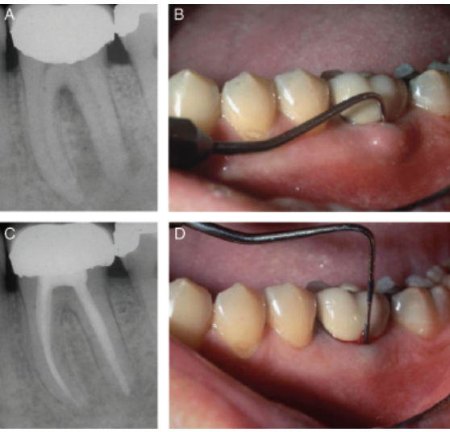
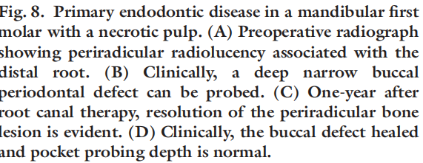

Slide 12
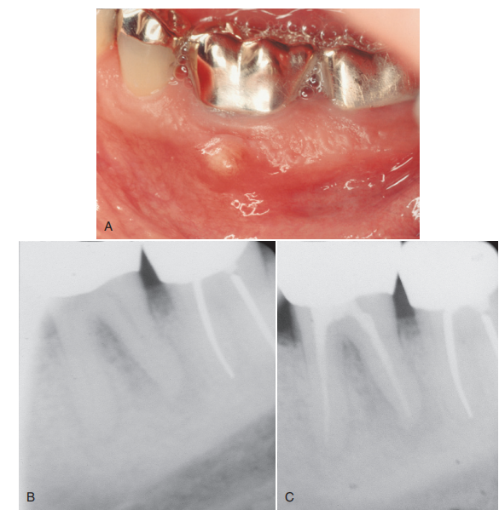
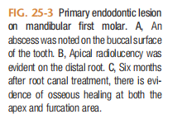

Slide 13
Primary endodontic diseases usually heal following root canal therapy. The sinus tract extending into the-gingival sulcus or furcation area disappears at an early stage once the necrotic pulp has been removed and the root canals are well sealed.
It is important to recognize that failure of any periodontal treatment will occur when the presence of a necrotic pulp has not been diagnosed and endodontic treatment has not followed.
Prognosis :Excellent.

Slide 14
PRIMARY PERIODONTAL LESION
Periodontal disease has a progressive nature.
It begins in the sulcus and migrates to the apex as deposits of plaque and calculus produce inflammation, causing loss of surrounding alveolar bone and supporting periodontal soft tissues.
This leads to a loss of clinical attachment and formation of a periodontal abscess during the acute phase of destruction

Slide 15
SIGNS AND SYMPTOMS
Teeth are vital
Generalized bone loss
There is frequently accumulation of plaque and calculus, with soft tissue inflammation
Broad based pockets
Mobility,
Periodontal abscess during acute phase of the disease.

Slide 16
DIAGNOSIS
Visual examination
Probing
Pulp testing
Radiographs

Slide 17
Careful periodontal examination usually reveals broad-based pocket formation and an accumulation of plaque and calculus.
The bony lesion is usually more widespread and generalized than are lesions of endodontic origin.

Slide 18
TREATMENT
Periodontal therapy
Root amputation
Guided tissue regeneration
Pulp space therapy (advanced cases).

Slide 19
PROGNOSIS
Depends on
the stage of periodontal disease
the extent of the periodontitis
the efficacy of periodontal treatment (Rotstein I et al, 2004).
the outcome of periodontal therapy.
the patient’s ability to comply with potential long term treatment and maintenance therapy.

Slide 20
The prognosis for teeth affected by periodontitis worsens as the disease process and periodontal destruction progress.

Slide 21
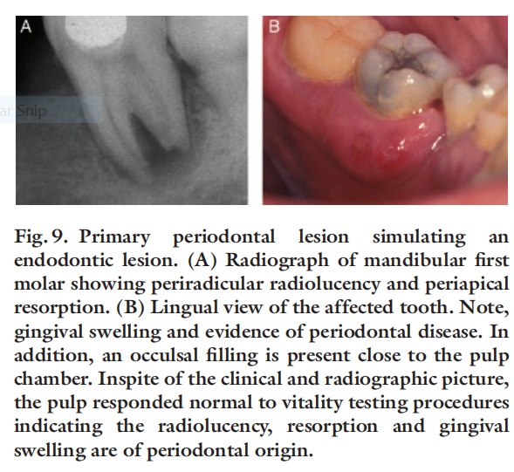

Slide 22
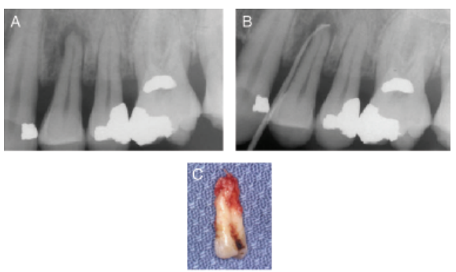
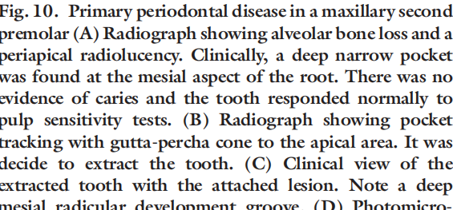

Slide 23
COMBINED LESION
The combined diseases include :
Primary endodontic disease with secondary periodontal involvement
Primary periodontal disease with secondary endodontic involvement
True combined diseases.

Slide 24
Primary endodontic lesion with secondary periodontal involvement
Etiopathogenesis
When a lesion of endodontic origin is not treated, pathosis usually continues, leading to destruction of the periapical alveolar bone and progression into the interradicular area, causing breakdown of surrounding hard and soft tissues .
As drainage persists through the gingival sulcus, accumulation of plaque and calculus in the purulent pocket results in periodontal disease and further apical migration of the attachment.

Slide 25
Tooth requires both endodontic and periodontal treatments.
If endodontic therapy is adequate, the prognosis depends on the
severity of periodontal involvement and
efficacy of periodontal therapy

Slide 26
TAKE HOME MESSAGE
Because of its history, the complex amalgam restorations may be the most frequently placed complex restoration.
However due to the increasing benefits of composites, the many types of auxiliary retention forms available, and the variations of tooth preparations required for complex restorations, the operator should be familiar with all of these techniques, if he or she is to use these restorations on a regular basis.

Slide 27
QUESTIONS
PRIMARY ENDODONTIC LESION
PRIMARY PERIODONTIC LESION
DIAGNOSIS

Slide 28
REFERENCES:
1. Sturdevant's Art and Science of Operative Dentistry - fourth Edition
2. Operative Dentistry - Modern theory and practice - First Edition- M.A. Marzouk
3. Text book of operative dentistry - Vimal K. Sikri
4.Fundamentals of Operative Dentistry- Summit JB- 2nd edition
5.Text book of operative dentistry → nisha carg,amit carg
6.Principles and Practice of Operative Dentistry-Gerald T. Charbeneau-Third edition.
7.Clinical operative dentistry-principles and practice→ramya Raghu,Raghu sreenivasan

Slide 29
THANK YOU

